Slide 1
Road Traffic Injuries Classifier
Muna Altherwi
18/11/2021

Slide 2
Problem Definition
To predict 'injury severity’
a multi-class classification based on analyzing the provided dataset.
From data specifications:
four groups:
1. Unharmed
2. Killed
3. Injured hospitalized
4. Slightly injured.
France, 2019

Slide 3
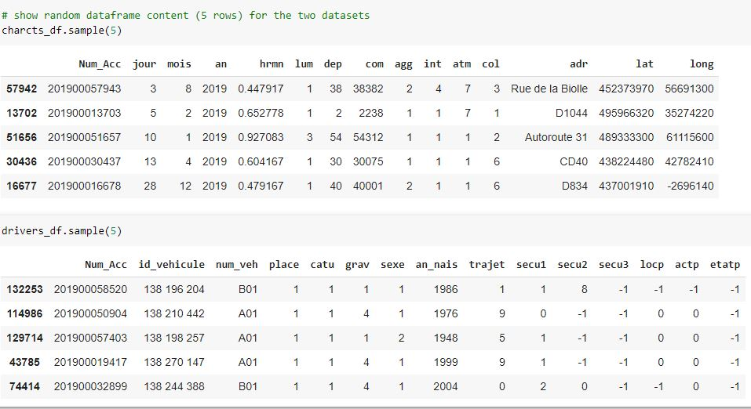
Data

Slide 4
Model Design
Data Cleaning:
null, duplication, translate, merge.
Feature engineering:
Correlation, Selection, PCA, Oversampling

Slide 5
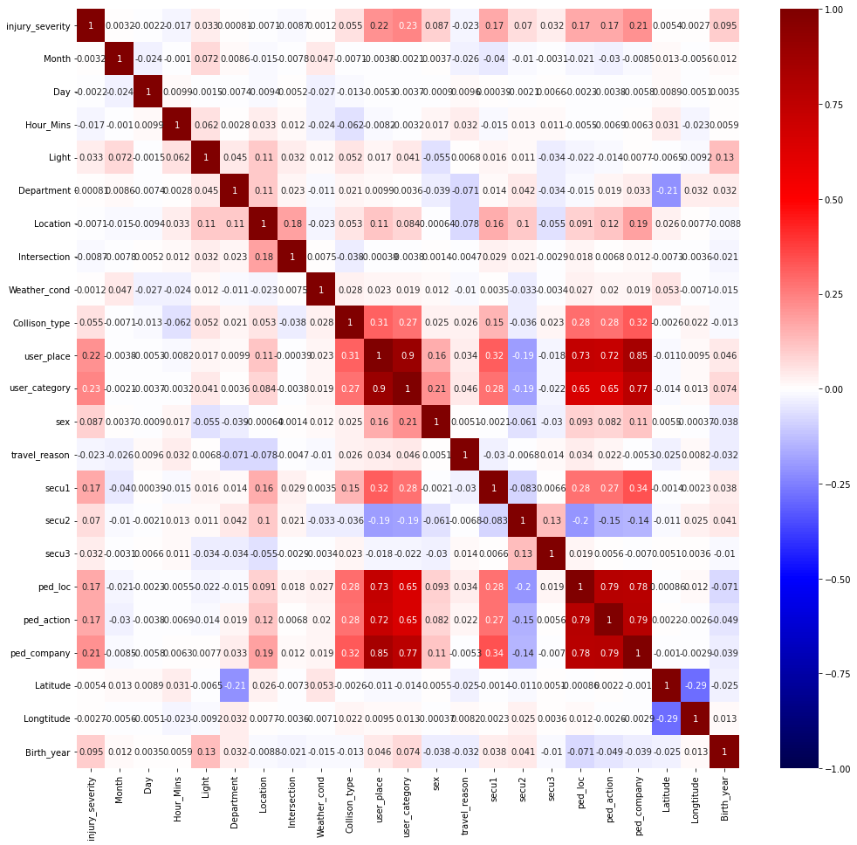

Slide 6
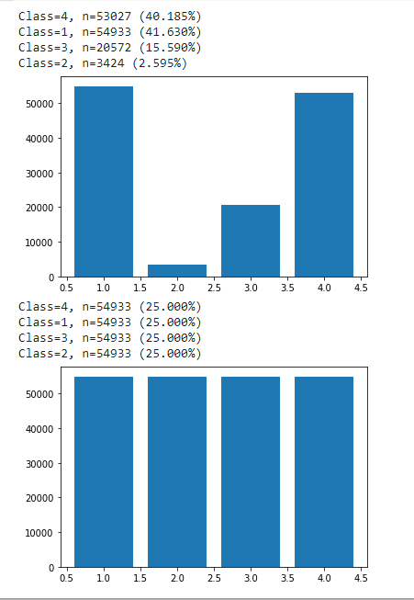
Handling Oversampling

Slide 7
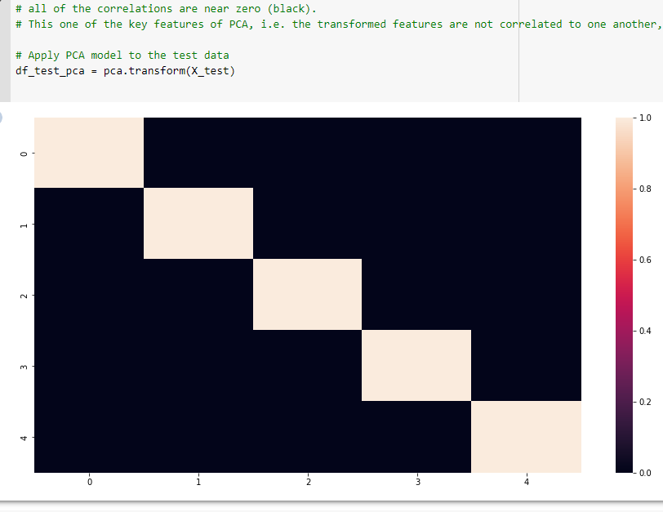
PCA

Slide 8
Algorithms
Oversampling: Random, SMOTE
Classification:
(1)Logistic Regressing,
(2)KNN,
(3)Decision Tree,
(4)Random Forest Tree, and
(5)Support vector machines

Slide 9
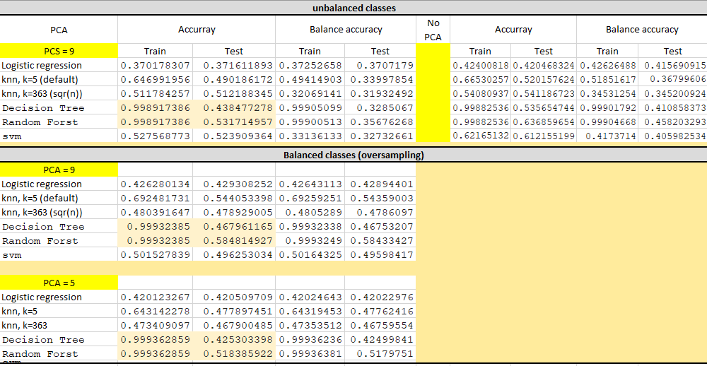
Results

Slide 10
Thank you

